Slide 1
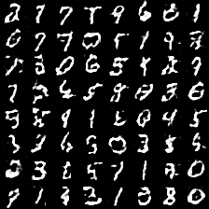
What Makes CREATIVITY?
Study of Generative Adversarial Networks(GANs)
Penny Brant, Nathan Sun

Slide 2
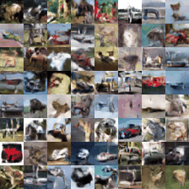
Why GANs?
Many Applications
Text to image in assistive tech
Generating CAPTCHA Images and cryptography in security
Super-resolution
One of the fastest growing fields in AI/ML
2000+ papers written between 2014(first paper published) till today
Center of many technology ethical debates
Is creativity an inherent human characteristic?
Deep Fakes and political polarization
We felt that learning about GANs would gain us insights to many of the above.

Slide 3
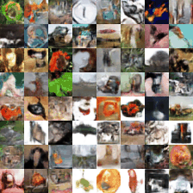
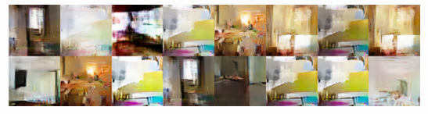
Background
Created in 2014 by Goodfellow et. al.
Idea of pitting the generator against the discriminator until the generated data is indistinguishable from the real data.
Are now hundreds of different types of GANs.
Ex. WGAN, DRAGAN, DCGAN, bicycleGAN, VEEGAN
Common problems - mode collapse & vanishing gradient
The generator collapses to a setting where it always produces the same outputs
It fails to learn to represent the complex real-world data distribution and gets stuck in a small space with extremely low variety.

Slide 4
Our Final Project
Literature Review:
The original GAN paper, and general math papers associated with GANs.(3 papers)
Papers on specific implementations, highlights which we implemented.(4 papers)
Implementation of the following models:
GAN(Generative Adversarial Network)
WGAN(Wasserstein GAN) - GAN with Wasserstein Distance
DRAGAN(Deep Regret Analytic Generative Adversarial Networks) - GAN with no regret algorithm

Slide 5
Lit Review

Slide 6
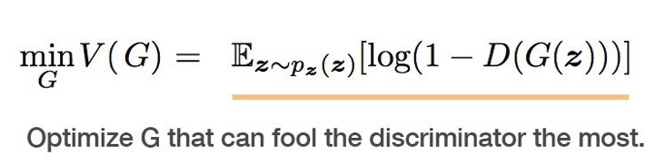
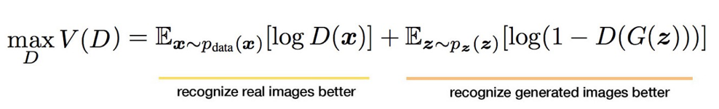
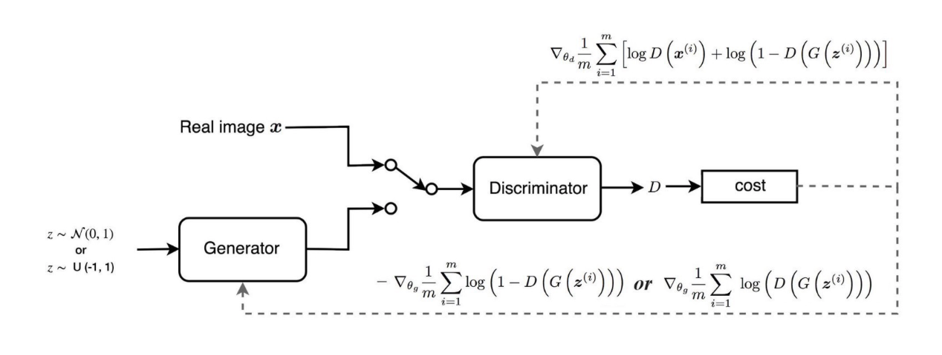
Zero Sum Min-Max Game

Slide 7
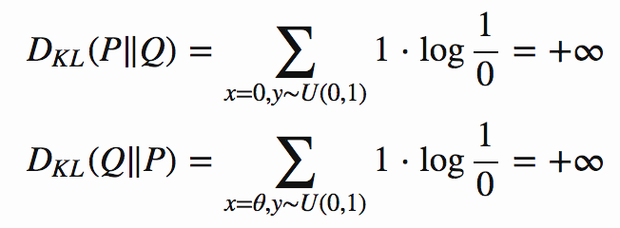
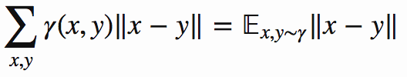
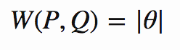
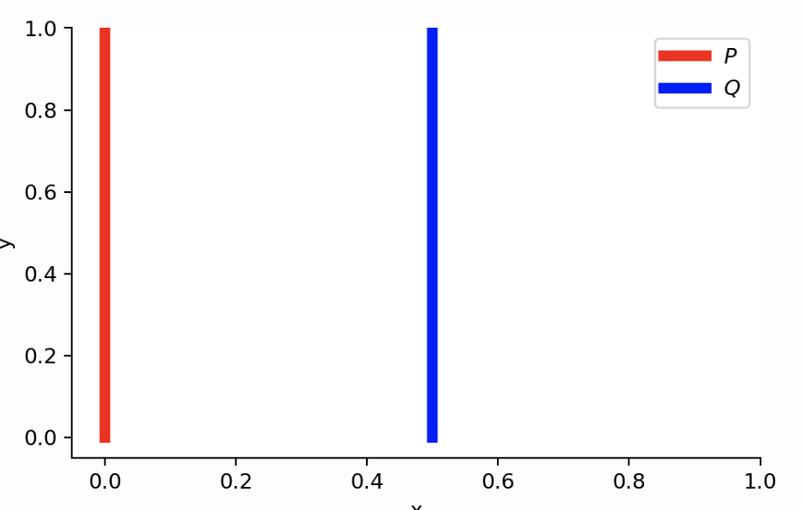
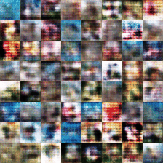
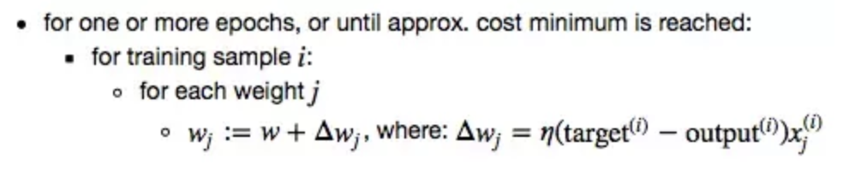
Wasserstein Distance
When p distributions are disjointed manifolds only Wasserstein metric provides smooth measure.
Wasserstein Distance/ Earth Mover’s distance
measure of the distance between two probability distributions.
Wasserstein Distance Cost Function:
Notes:
Weight mover is probabilistic because it depends on the weight of the dirt and the distance it needs to cover.
When manifolds are disjoint, we are always capable of finding a perfect discriminator that separates real and fake samples 100% correctly.

Slide 8
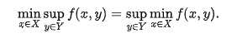
GAN Convergence
Mode Collapse is hypothesized to be due to min-max game converging towards a bad local minima.
Let V be a compact convex subset of a linear topological space. Let J(D, G) denote the convex cost of the discriminator with respect to an almost ideal generator.
J(G) is compact quasiconvex function across the domain of n-th dimension space
J(D) is compact quasi concave function across domain of m-th dimension space
According to Sion’s theorem, f(x) X f(y), f(x, y) is a convex function in its first argument and concave in its second argument. Using standard argument, it could be conjectured that:
Which suggests that a local convex equilibrium is exists in the min-max game.
Notes:
Infimum- greatest lower bound
Supremum- least upper bound

Slide 9
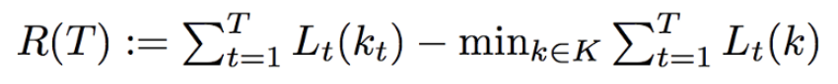
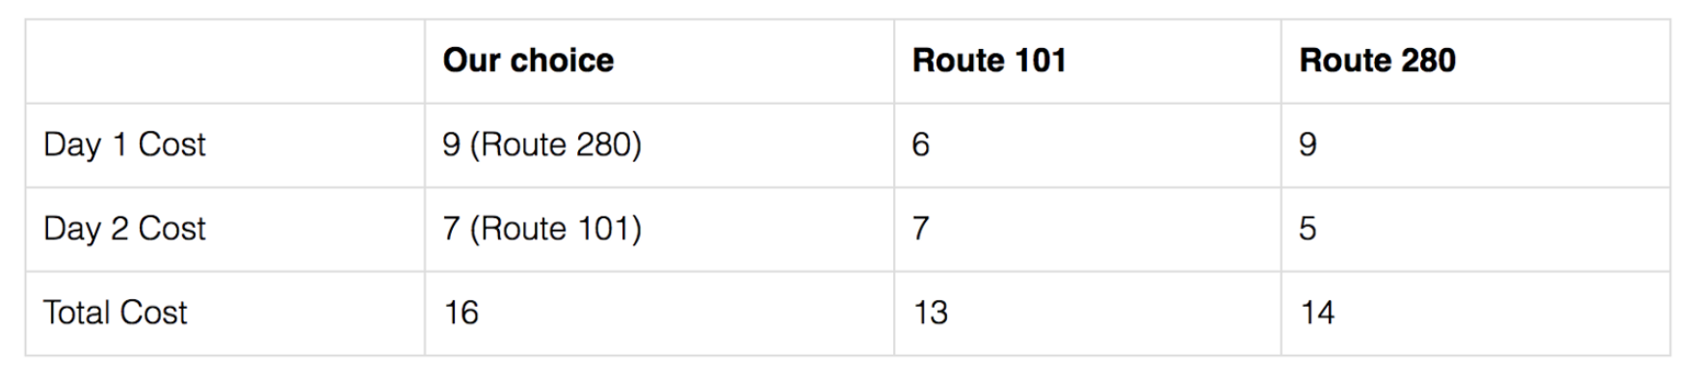
No Regret Algorithm
Given a convex set of cost functions L1, L2….belonging to real numbers and an algorithm that selects the different loss functions L(x), the regret function is defined as below:
Let V denote the cost at equilibrium,
The behavior of the regret algorithm suggests that it doesn’t increase over different iterations, and therefore R(t)/T is an O(1) function and therefore the above function is bounded by both sides to converge to V*.

Slide 10
Implementations

Slide 11
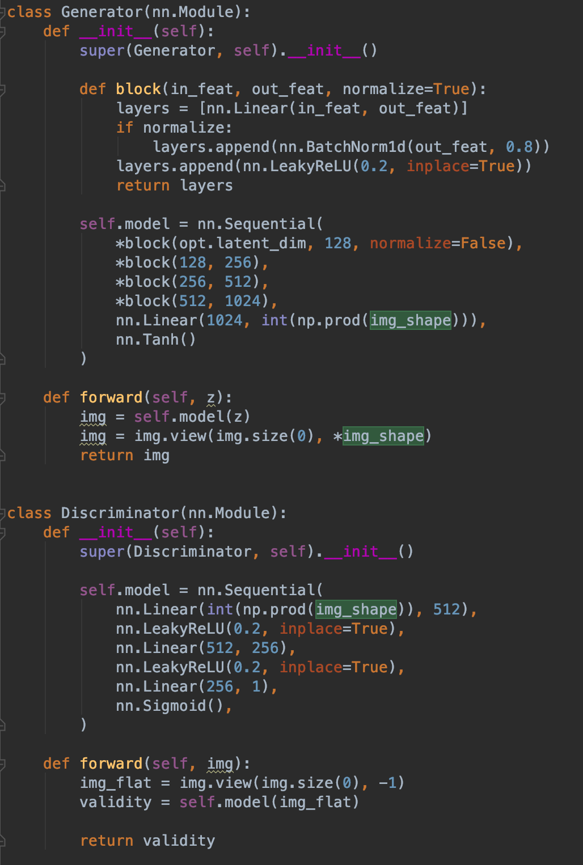
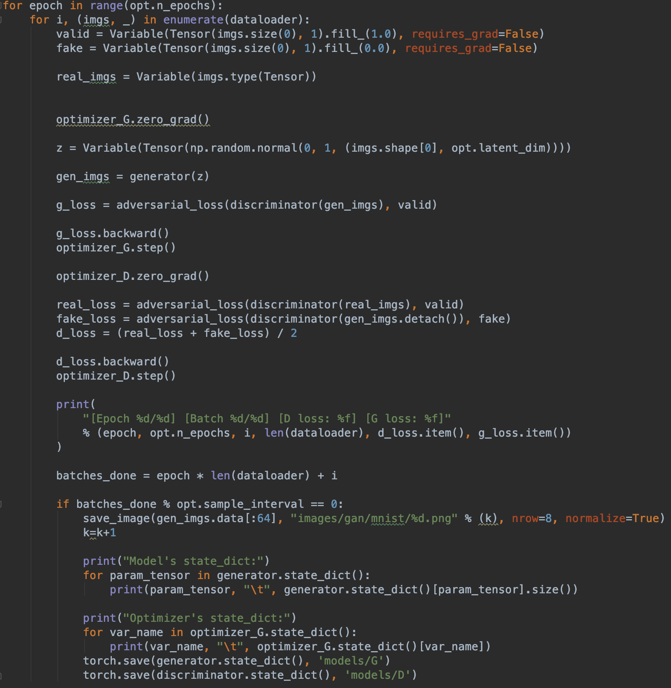
Our First Step: GAN

Slide 12
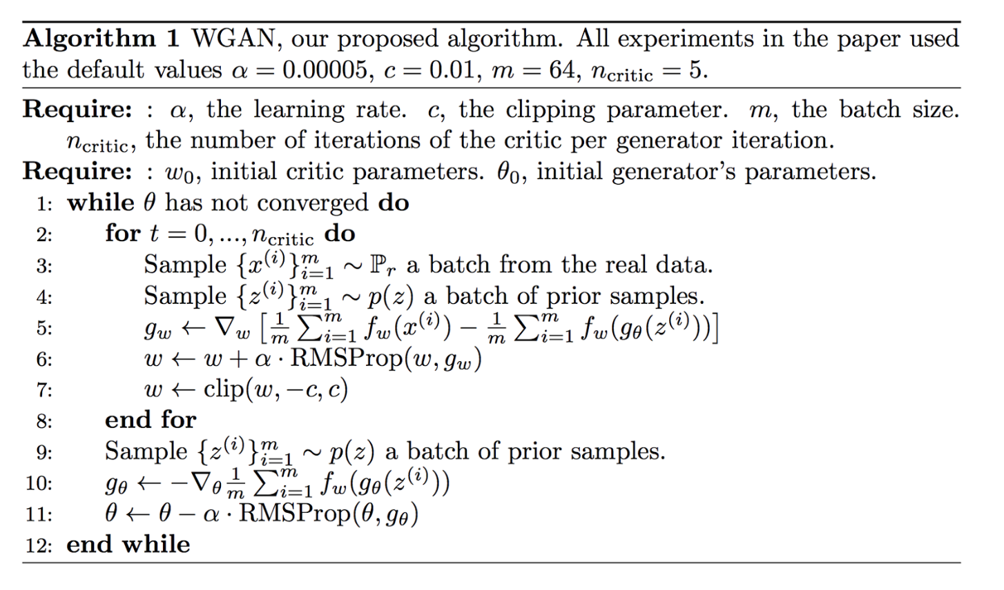
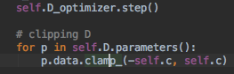
WGAN
WGAN proposes a new cost function using Wasserstein distance that has a smoother gradient everywhere.
Lipschitz constraint restricts the weights of the discriminator, determined by hyperparameters.
One way to enforce the constraint is through clipping
Fixes mode collapse

Slide 13
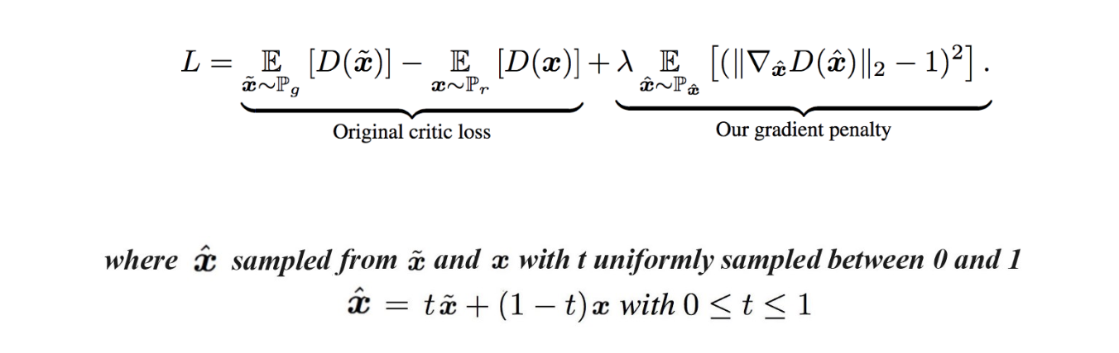
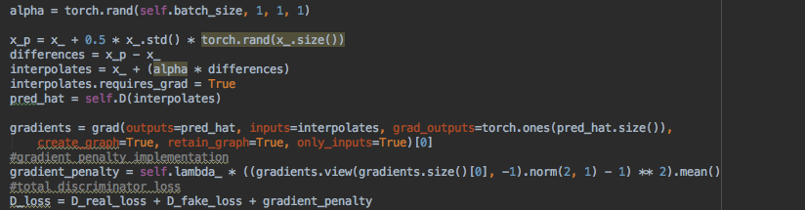
How to Train Your DRAGAN
DRAGAN- Deep Regret Analytical Generative Adversarial Network
Implements a gradient penalty scheme, which penalizes the model if the gradient norm moves away from its target norm value 1.
Instead of clipping, DRAGAN uses GP to enforce the Lipschitz constraint.
Enhances training stability- better convergence
Notes:
Although without rigorous proof, the paper hypothesizes mode collapse due to the min max game converging to a bad local equilibria in non-entirely convex games. To counter this effect, the paper suggests the use of gradient penalty points through a gradient penalty scheme called DRAGAN (Deep Regret Analytic Generative Adversarial Networks).

Slide 14
Thanks For Watching!
Thanks for being in this amazing course with us, and special thanks to Ms. Brockmyre and the CS department which made this class possible.

